Slide 1
QUICK FACTS
Start: May 2012
Finish: May 2015
WP 4 Holder: HZJZ
Total budget: € 3.360.548,96
WPs no: WP1-WP6
Partners: 11+12
www.patientregistries.eu
Martina Jelinić, HZJZ
Vanja Pajić, HZJZ

Slide 2
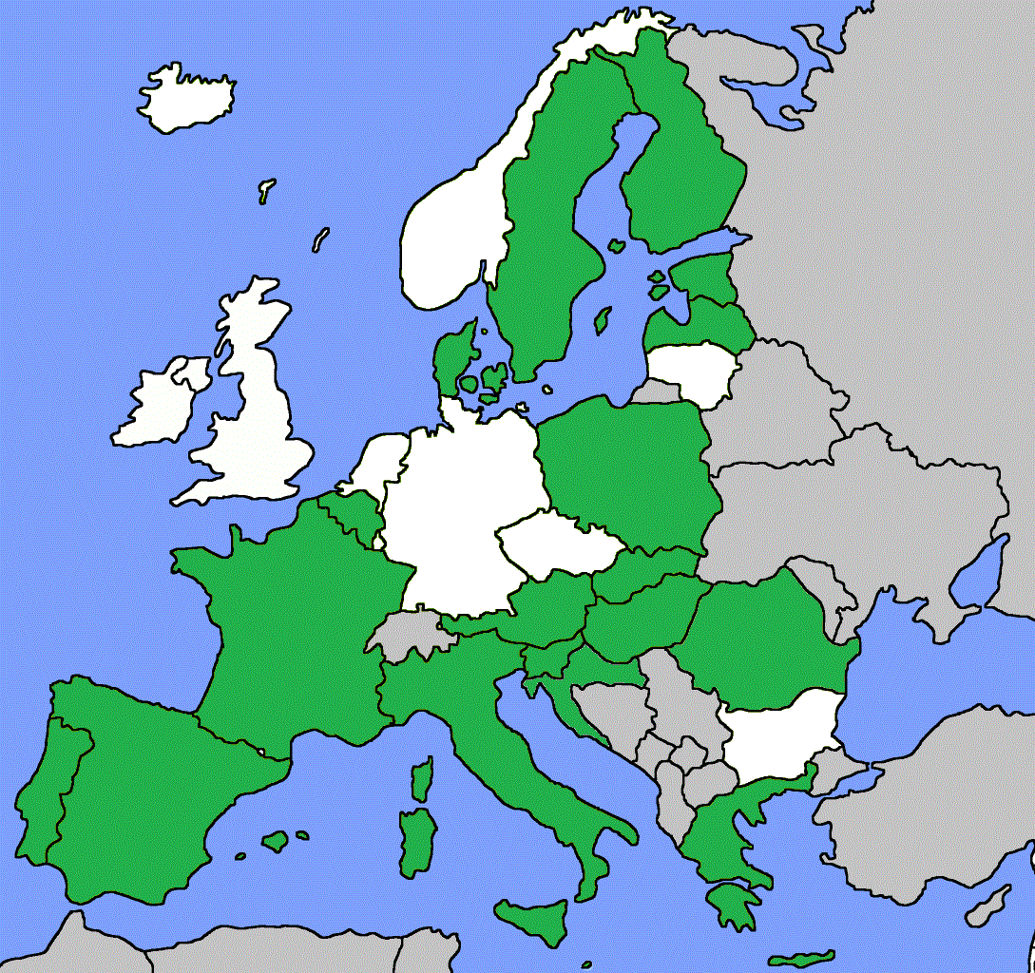
Geographically: the EU, EFTA, and accession countries are included (11 associated and 12+ collaborative partners)
According to different governance of registries: regional, national and supranational registries

Slide 3
JA Aims
Mapping of existing EU, regional and national patient registries
Identification of existing EU projects
Interoperability
Best practices
One patient registry of registries across EU
www.patientregistries.eu

Slide 4
JA Activities
Country level registries best practice identification and applied research methodology
EU & global best practices identification
Literature review
Cross-border legislation on patient data sharing
EU-level Registry of registries design and development
www.patientregistries.eu

Slide 5
Financing
Total financing
€ 3.360.548,96
EU co-financing - WP4 CRO (60%)
€ 341.957,45
Cro Ministry of Health co-financing (40%)
€ 143.380,83
www.patientregistries.eu

